Slide 1

GOOD EVENING
Hi!!
I am Mark Deson S. Cuñado
II - BSAT
SPEAKER OF THE NIGHT

Slide 2

MAJOR TYPES OF PLANS
Objective or Goals
Policies
Mission
Procedures
Long-Range and
Short-Range Objectives
Rules
Budget
Philosophy
MBO
Program
Strategy

Slide 3

Guidelines in Implementing
Management by Objectives

Slide 4

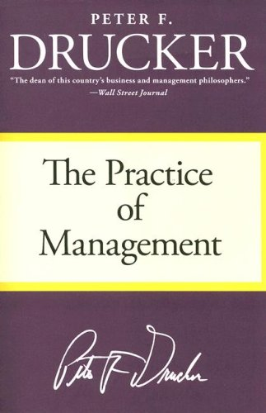
Peter Ferdinand Drucker
(November 19, 1909 – November 11, 2005) was an influential writer, management consultant, and self-described “social ecologist.”

Slide 5

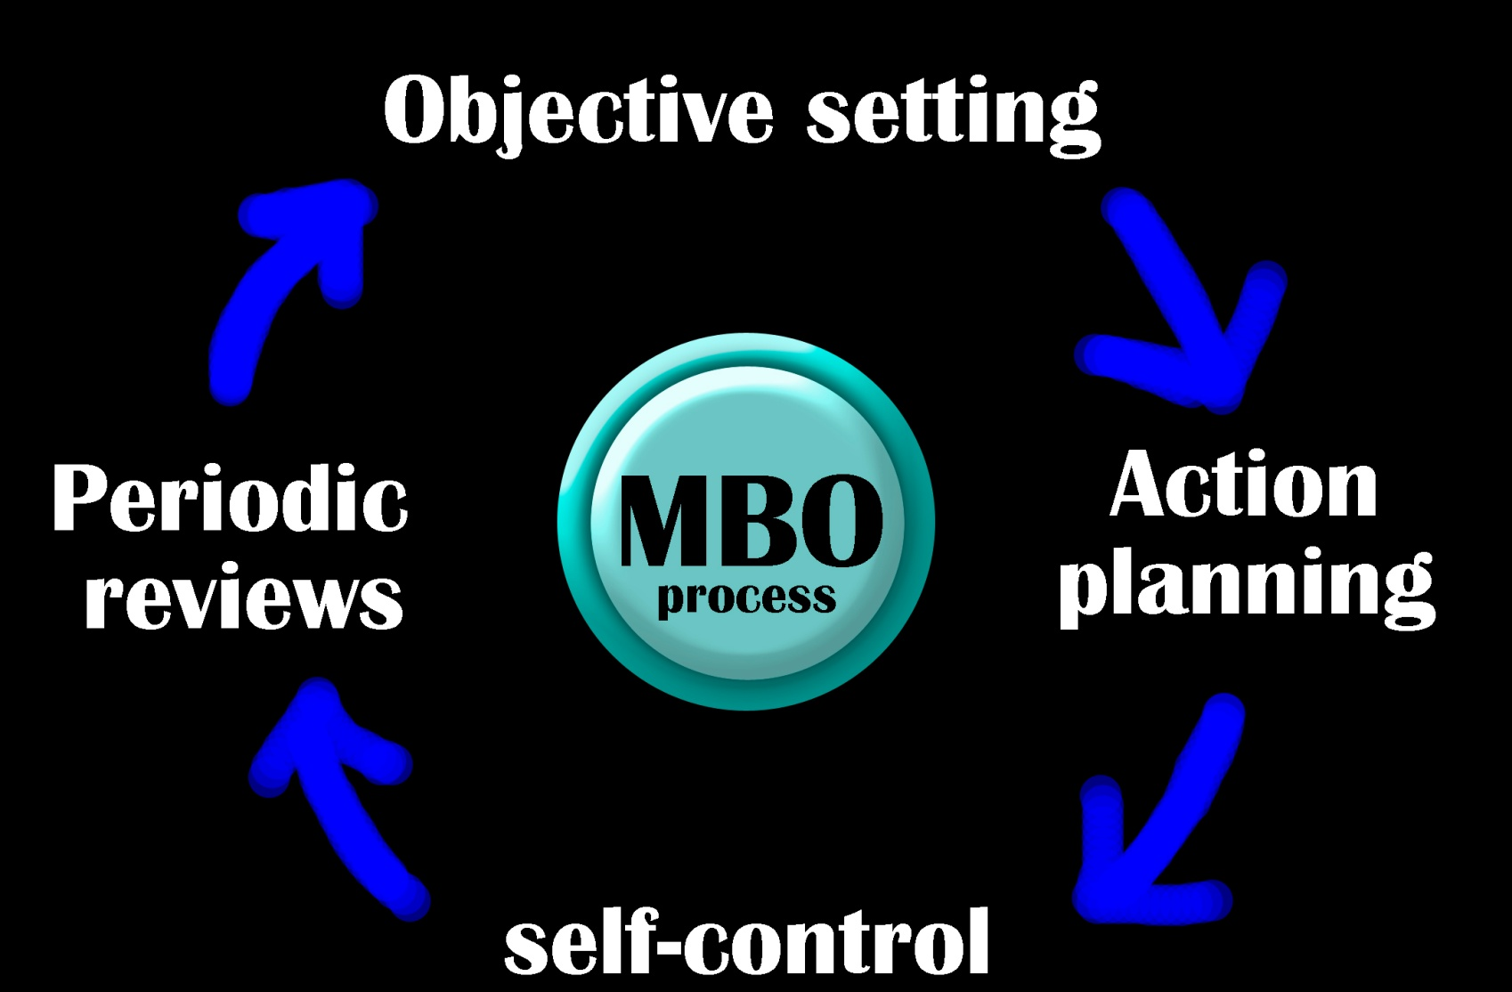
The MBO Process

Slide 6

Objective setting
1. Formulate long-range Organizational objectives.
2. Develop specific divisional objectives.
3. Establish departmental objectives.
4. Set individual job objectives.

Slide 7

Action planning
5. Formulate action plans.

Slide 8

Self-control
6. Implement and take corrective action.

Slide 9



Periodic reviews
7. Review progress toward objectives.
8. Appraise overall performance, reinforce behavior, and strengthen motivation through:
Manager training and self-development
Compensation
Career and manpower

Slide 10
PROGRAM
It is the actual course of action designed to carry out the established objective.

Slide 11


Project Schedule
Refers to identification and analysis of the activities from the project planning stage up to the start of normal operations.

Slide 12
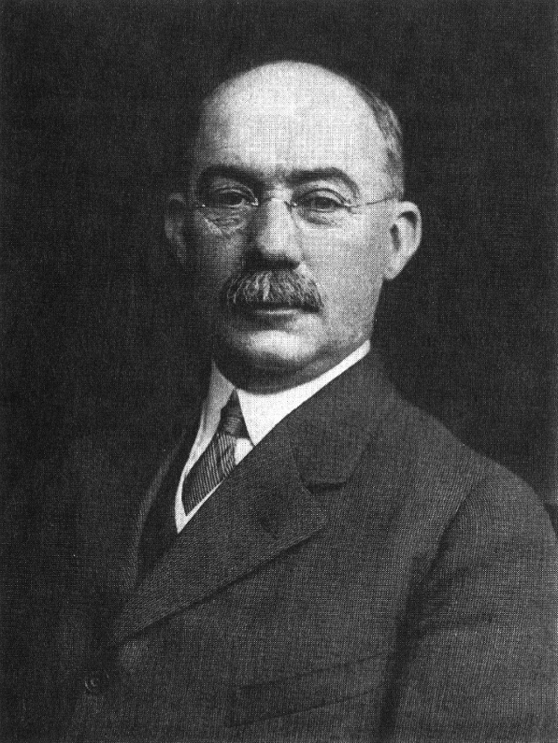
Henry Laurence Gantt,
A.B., M.E.
(1861 – 23 November 1919) was an American Mechanical Engineer and management consultant who is most famous for developing the Gantt Chart in the 1910s.

Slide 13
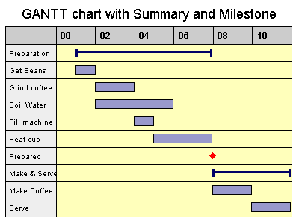
A Gantt chart is a type of bar chart, developed by Henry Gantt, that illustrates a project schedule. Gantt charts illustrate the start and finish dates of the terminal elements and summary elements of a project.

Slide 14
POLICIES
These are basic guidelines for action.

Slide 15

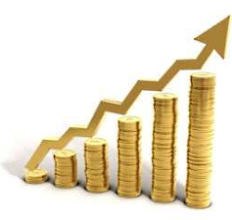
Major policies
Profit Maximation
Product/Service the Firm Will Produce or Sell
Position within the Industry
Geographic Market
Product Quality
Ownership
Social Responsibility

Slide 16
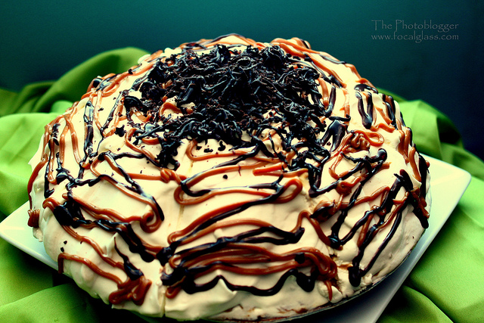

Major policies
Product/Service the Firm will Produce or Sell

Slide 17

Major policies
POSTION WITHIN THE INDUSTRY

Slide 18

Major policies
GEOGRAPHIC MARKET

Slide 19

Major policies
PRODUCT QUALITY

Slide 20

Major policies
OWNERSHIP

Slide 21


Major policies
SOCIAL RESPONSIBILITY

Slide 22
PROCEDURES
Series of related steps expressed in chronological order for specific purpose.

Slide 23
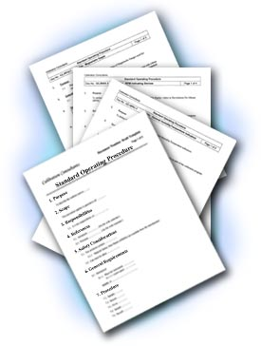
An SOP is a written document or instruction detailing all steps and activities of a process or procedure.

Slide 24
RULES
Require specific and definite actions for a given situation.

Slide 25



Slide 26
BUDGET
A plan stated in financial terms.

Slide 27
PHILOSOPHY
  The values and beliefs an organization holds as the guiding light.

Slide 28
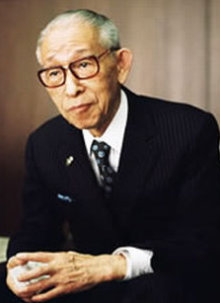
Konosuke Matsushita
(November 27, 1894 – April 27, 1989) was a Japanese industrialist, the founder of Panasonic, a company based in the suburb of Kadoma, Osaka in Japan. For many Japanese, he is known as "the god of management".

Slide 29

STRATEGY
It is the method of shaping a company’s future and involves determining the long-run direction of the organization.

Slide 30


THANK YOU
FOR LISTENING
http://markdeson.webnode.com/documents/
Click: MGT report.docx / MGT report.pptx

Slide 31






ACKNOWLEDGEMENT
MARK DESON S. CUÑADO
MGT 1B
PROFESSOR ARCHIE REYES
(7:30-8:30)
THANK YOU VERY MUCH!
http://markdeson.webnode.com
© 2012 All rights reserved

